Slide 1
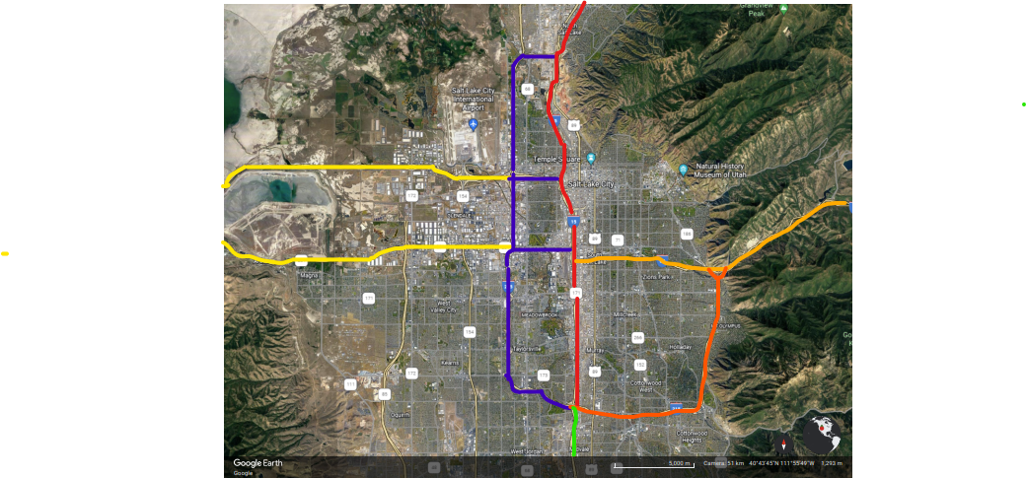
UDOT INCIDENT MANAGEMENT SL County Patrol vs Response Area

Slide 2
Salt Lake County Patrol Salt Lake County is broken up into 6 patrol areas:
I-15 is broken up into 2 patrol areas 1 and 3
Area 1 MM 311 to I-215 interchange
When patrolling Area 1, IMT will patrol from 7200 S to 2600 S “Davis County” giving overlap.
Area 3 I-215 Interchange to MM 286
When patrolling Area 3, IMT will patrol for 5300 S to SR 92 “Timp. Hwy” giving overlap.

Slide 3
Salt Lake County Patrol Salt Lake County is broken up into 6 patrol areas
I-80 is broken up into 2 patrol areas 5 and 6
Area 5 MM 99 to MM 119 I-215 W Belt
When patrolling Area 5, IMT will patrol from MM 99 to Redwood RD “Into Area 4”
Area 6 MM 122 to MM 140
When patrolling Area 6, IMT will patrol from I-15 to Summit Park.
SR 201 is tied into area 5
Area 5 MM 0 to MM 15
When patrolling 201, IMT will patrol from MM 0 to Redwood Rd “into area 4”

Slide 4
Salt Lake County Patrol Salt Lake County is broken up into 6 patrol areas
I-215 is broken up into 2 patrol areas
Area 4 I-215 W MM 12 to MM 27
When patrolling I-215 W, IMT will patrol from I-15 SLC turning at 7200 S Area 3 or 5300 S Area 1 to I-15 turning at 2600 S DCO. Area 4 also covers small routes of I-80 and SR 201 between I-215 W and I-15.
Area 2 I-215 E MM 0 to MM 12
When patrolling I-215 E, IMT will patrol From MM 0 to MM 12 and cover the .5 mile stretch “Rocky Rd” from I-215 E to I-80.

Slide 5
Salt Lake County Patrol Salt Lake County is broken up into 6 patrol areas
When working SLC Each IMT will be assigned a Patrol Area and are broken up as follows:
Area 1 (13 Miles) Area 6 (18 miles)
Area 4 (15 Miles) Area 5 (20 miles)
Area 2 (12 Miles) Area 3 (21 miles)
Areas can also be broken up as seen fit by Supervisors, Please see attached map. SLCO IMT will respond at the request of local or state agencies to assist on the following roads, Redwood RD, State Street, Foothill or surface street to assist with crashes as needed at the request of his/her supervisor.
Hot areas “Primetime” for SLC 16:00 to 19:30 hrs
Area’s 1 and 3 I 15 mileposts 284-314
Area’s 5 and 6 I 80 mileposts 113-132
Area’s 5 SR 201 mileposts 9-17
Area’s 2 and 4 I 215 mileposts 0-27

Slide 6
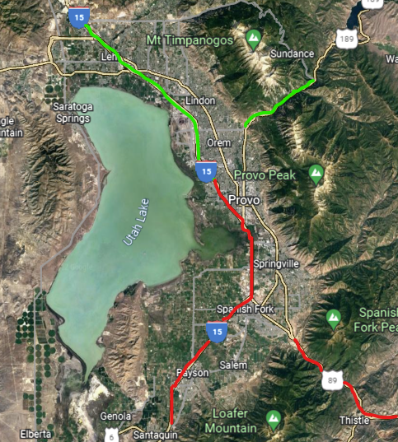
UDOT INCIDENT MANAGEMENT UT County Patrol vs Response Area

Slide 7
UDOT INCIDENT MANAGEMENT UT County Patrol vs Response Area
UT County Is broken up into 2 Areas, North and South
North Area I-15 MM 271 to MM 279 (8 Miles)
When patrolling UTCO North, IMT will Patrol Orem Center St I-15 to Timp. Hwy MM 279 “Timp. Hwy” IMT will turn at 14600 S to give overlapping coverage.
SR 92 (19 Miles)
Utah County IMT will respond as needed SR 92 from MM 8 to MM 27 Better known as the Alpine Loop to any of the following PI crashes, Lane Blocking Incidents Etc if available.
SR 189 (7 Miles)
Utah County IMT will also Patrol SR 189 MM 8 to MM 15 respond as needed for Calls.

Slide 8
UDOT INCIDENT MANAGEMENT UT County Patrol vs Response Area
UT County Is broken up into 2 Areas, North and South
South Area I-15 MM 271 to MM 242 (29 miles)
When patrolling UTCO South, IMT will patrol I-15 MM271 to I-15 MM 243. IMT will turn at MM242 “Rocky Ridge” to give overlapping coverage.
HWY 6 E of I-15 (33 miles)
Utah County IMT will respond as needed HWY 6 from MM 178 to MM 211 for any of the following PI crashes, Lane Blocking Incidents Etc if available. UTCO IMT will also attempt to patrol the area as needed to assist motorists.
HWY 6 W of I-15 (10 miles)
Utah County IMT will Respond as needed MM 160 to mm150 to assist at the request of troopers and or Dispatch to reports of Blocking Crashes, PI or Fatalities.

Slide 9
UDOT INCIDENT MANAGEMENT UT County Patrol vs Response Area
Areas can also be broken up as seen fit by Supervisors, Please see attached map. UTCO IMT will respond at the request of local or State agencies to assist on the following roads
Redwood RD, State Street or surface street to assist with crashes as needed or at the request of his/her supervisor.
Hot areas “Primetime” for UTCO 16:00 to 19:30 hrs
I 15 mileposts 253-288

Slide 10
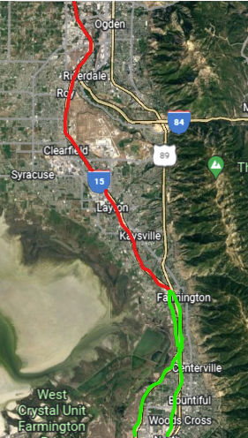
UDOT INCIDENT MANAGEMENT Davis County Patrol vs Response Area

Slide 11
UDOT INCIDENT MANAGEMENT Davis County Patrol vs Response Area
Davis County Is Broken up into 2 Areas, North and South
North Area I-15 MM 323 to MM 342 “31st” (19 miles)
When patrolling DCO North, IMT will patrol I-15 MM 342 to I-15 MM 323 . IMT May turn at MM 319 “400 N” to provide overlapping coverage.
DCO IMT may respond as needed or at the request of Dispatch, State or Local agencies as needed I-84 to MM 95, HWY 89 for any of the following PI crashes, Lane Blocking Incidents Etc if available.

Slide 12
UDOT INCIDENT MANAGEMENT Davis County Patrol vs Response Area
Davis County Is Broken up into 2 Areas, North and South
South Area I-15 MM 315 to MM 323 “Park LN” (8 miles)
When patrolling DCO South, IMT will patrol I-15 MM 323 to I-15 MM 315 . IMT May turn at MM 311 “Warm Springs” to provide overlapping coverage.
Legacy Pkwy MM 12 to MM 0 (12 miles)
When patrolling Legacy Pkwy, DCO IMT may turn a 2100 N I-215 W to provide overlapping coverage.
Hot areas “Primetime” for Davis CO 16:00 to 19:30 hrs
I 15 mileposts 310-340
Legacy highway mileposts 0-12
I 215 mileposts 26-28

Slide 13
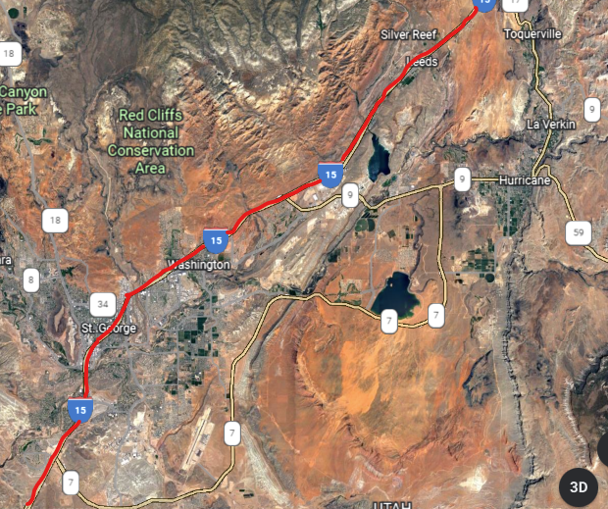
UDOT INCIDENT MANAGEMENT St George Patrol vs Response Area

Slide 14
UDOT INCIDENT MANAGEMENT St George Patrol vs Response Area
St George has one patrol area
St George I-15 from MM 0 to MM 42 “Iron County Ln”
STG has one patrol route, that route is I-15 MM 0 to MM 16 “SR-9” this is also STG Hot Spot or “Primetime”
STG IMT will also respond as needed or at the request of Dispatch, State or Local
agencies to SR 18, SR 9, SR 7 and SR 34 for Blocking, PI or Fatality Crashes.

Slide 15
Any Questions?

